Slide 1
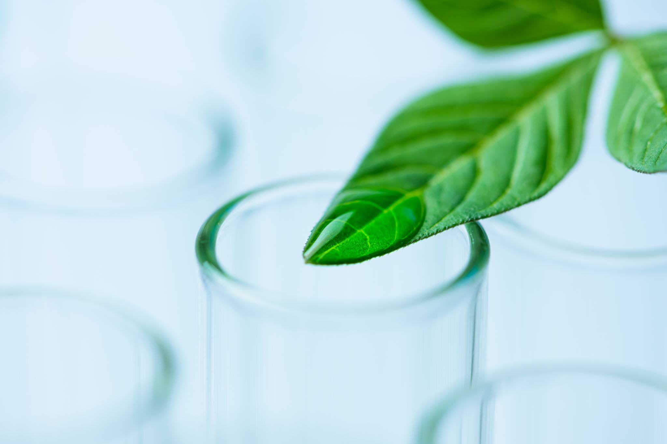
AGRICULTURE LEAF DISEASE CLASSIFICATION USING DEEP LEARNING
GUIDED BY : MRS. S.SANGEETHA
Submitted by
RAVEEN D (960121243038)
DEEPAK M (960121243012)
RACHEL D (960121243035)
ANUSHA S (960121243006)

Slide 2
Abstract
Agriculture leaf disease classification using deep-learning focuses on the detection of plant diseases using deep learning techniques, specifically leveraging the MobileNetV2 architecture. The Plant Village - Agricultural Leaf Disease Dataset, which includes a large collection of leaf images from 42 disease classes, is used for training, testing, and validating the model. The dataset comprises 28,830 images in both the training and test sets, with an additional 11,527 images in the validation set. The images are categorized into different classes representing various plant diseases or healthy leaves. The core of the detection system is MobileNetV2, a lightweight and efficient deep convolutional neural network (CNN) architecture developed by Google. MobileNetV2 is designed for mobile and embedded vision applications, balancing high accuracy with low computational cost. It utilizes depthwise separable convolutions, significantly reducing the number of parameters and operations compared to traditional CNNs, making it suitable for resource-constrained devices. Moreover, Inverted Residuals and Linear Bottlenecks allow the model to maintain performance with fewer resources, ensuring efficient feature extraction for image classification tasks. Pre-trained on the ImageNet dataset, MobileNetV2 is fine-tuned for plant disease detection, including conditions such as Apple Scab, Leaf Blast, and Powdery Mildew. The model can be deployed on mobile devices and IoT systems for real-time plant disease classification and monitoring. This system aims to automate plant disease detection, providing an effective tool for agricultural monitoring, ensuring timely intervention, and reducing the spread of plant diseases.

Slide 3

Problem Statement
Manual disease detection is time-consuming and inaccurate; AI automates this process, enabling faster and more accurate diagnoses.

Slide 4

Overview of Dataset
Dataset Name:
Plant Village - Agricultural Leaf Disease Dataset
Description:
The dataset is a large collection of leaf images for various crop plants. Each image is categorized into a specific disease class or marked as healthy.
Dataset Composition:
Training Set:
Total Images: 28,830
Number of Classes: 42
Test Set:
Total Images: 28,830
Number of Classes: 42
Validation Set:
Total Images: 11,527
Number of Classes: 42

Slide 5
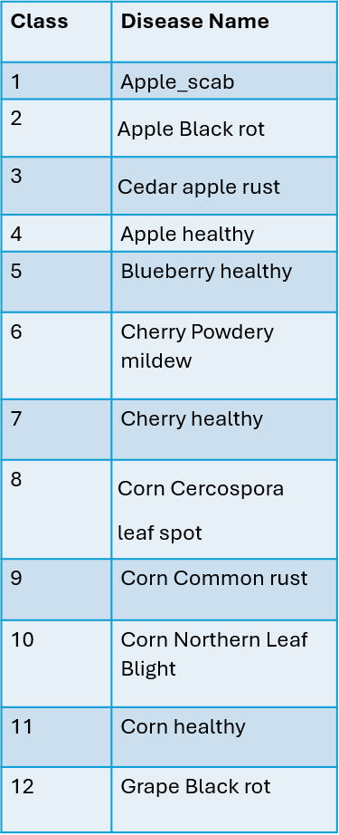
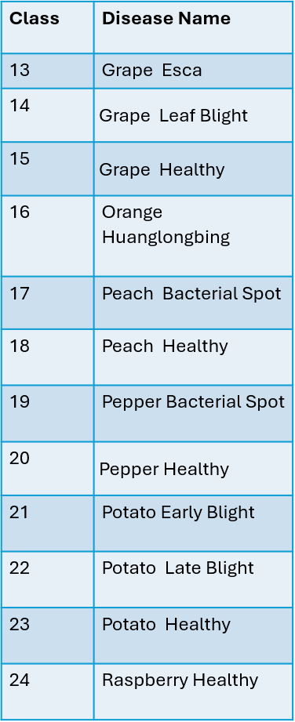
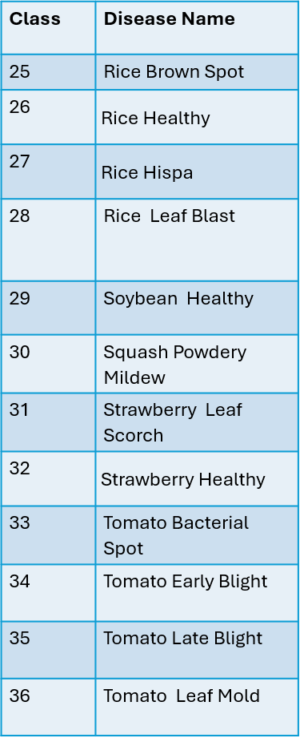
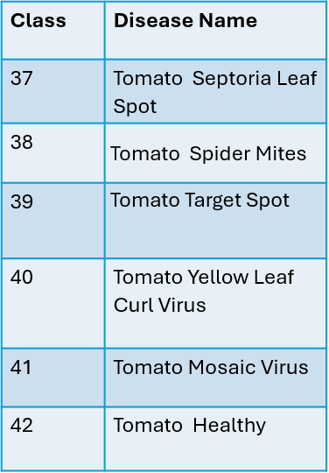
Classes in Dataset

Slide 6
Disease Detection Process
Images of plant leaves are fed into MobilenetV2 for classification.

Slide 7
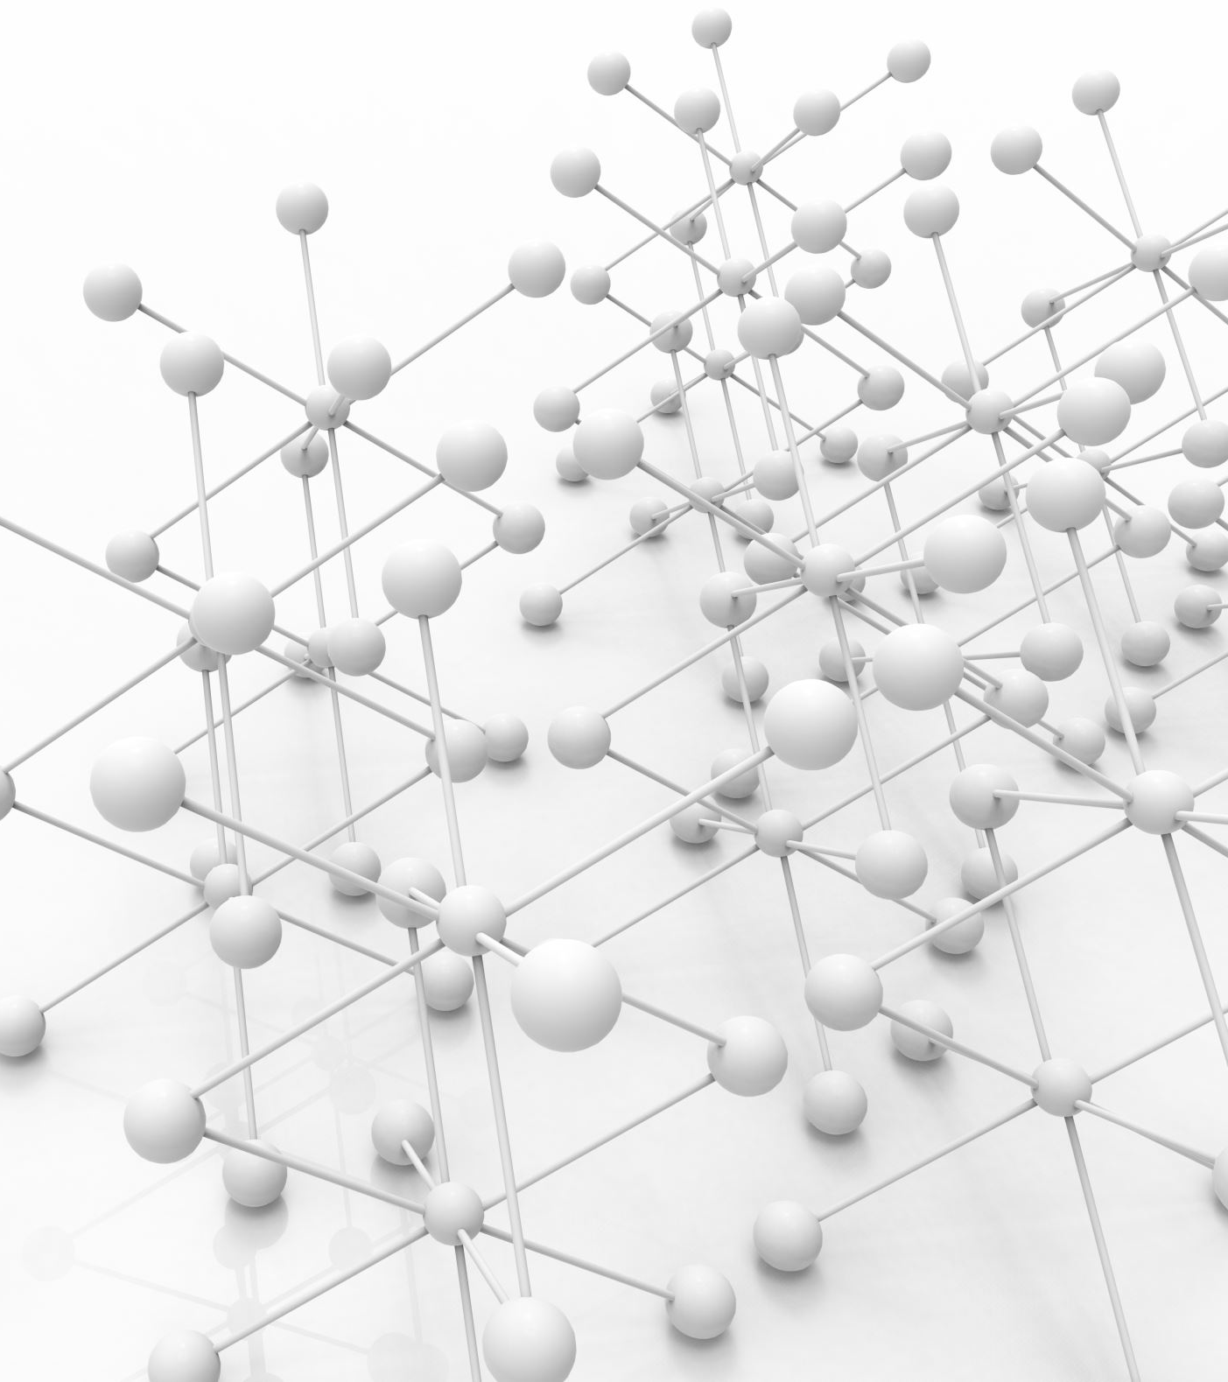
MobileNetV2Model
MobileNetV2 is a lightweight deep convolutional neural network (CNN) architecture developed by Google.
Designed for mobile and embedded vision applications, it balances high accuracy with low computational cost and memory usage.
Uses depthwise separable convolutions, significantly reducing the number of parameters and operations compared to standard convolutions.
Introduces "Inverted Residuals" and "Linear Bottlenecks", which help the model learn efficient representations while maintaining performance, even with fewer resources.
Efficient at handling image classification tasks on resource-constrained devices, such as smartphones and IoT devices.
Pre-trained on the ImageNet dataset, enabling transfer learning for custom applications like plant disease detection, medical imaging, and real-time object classification.

Slide 8
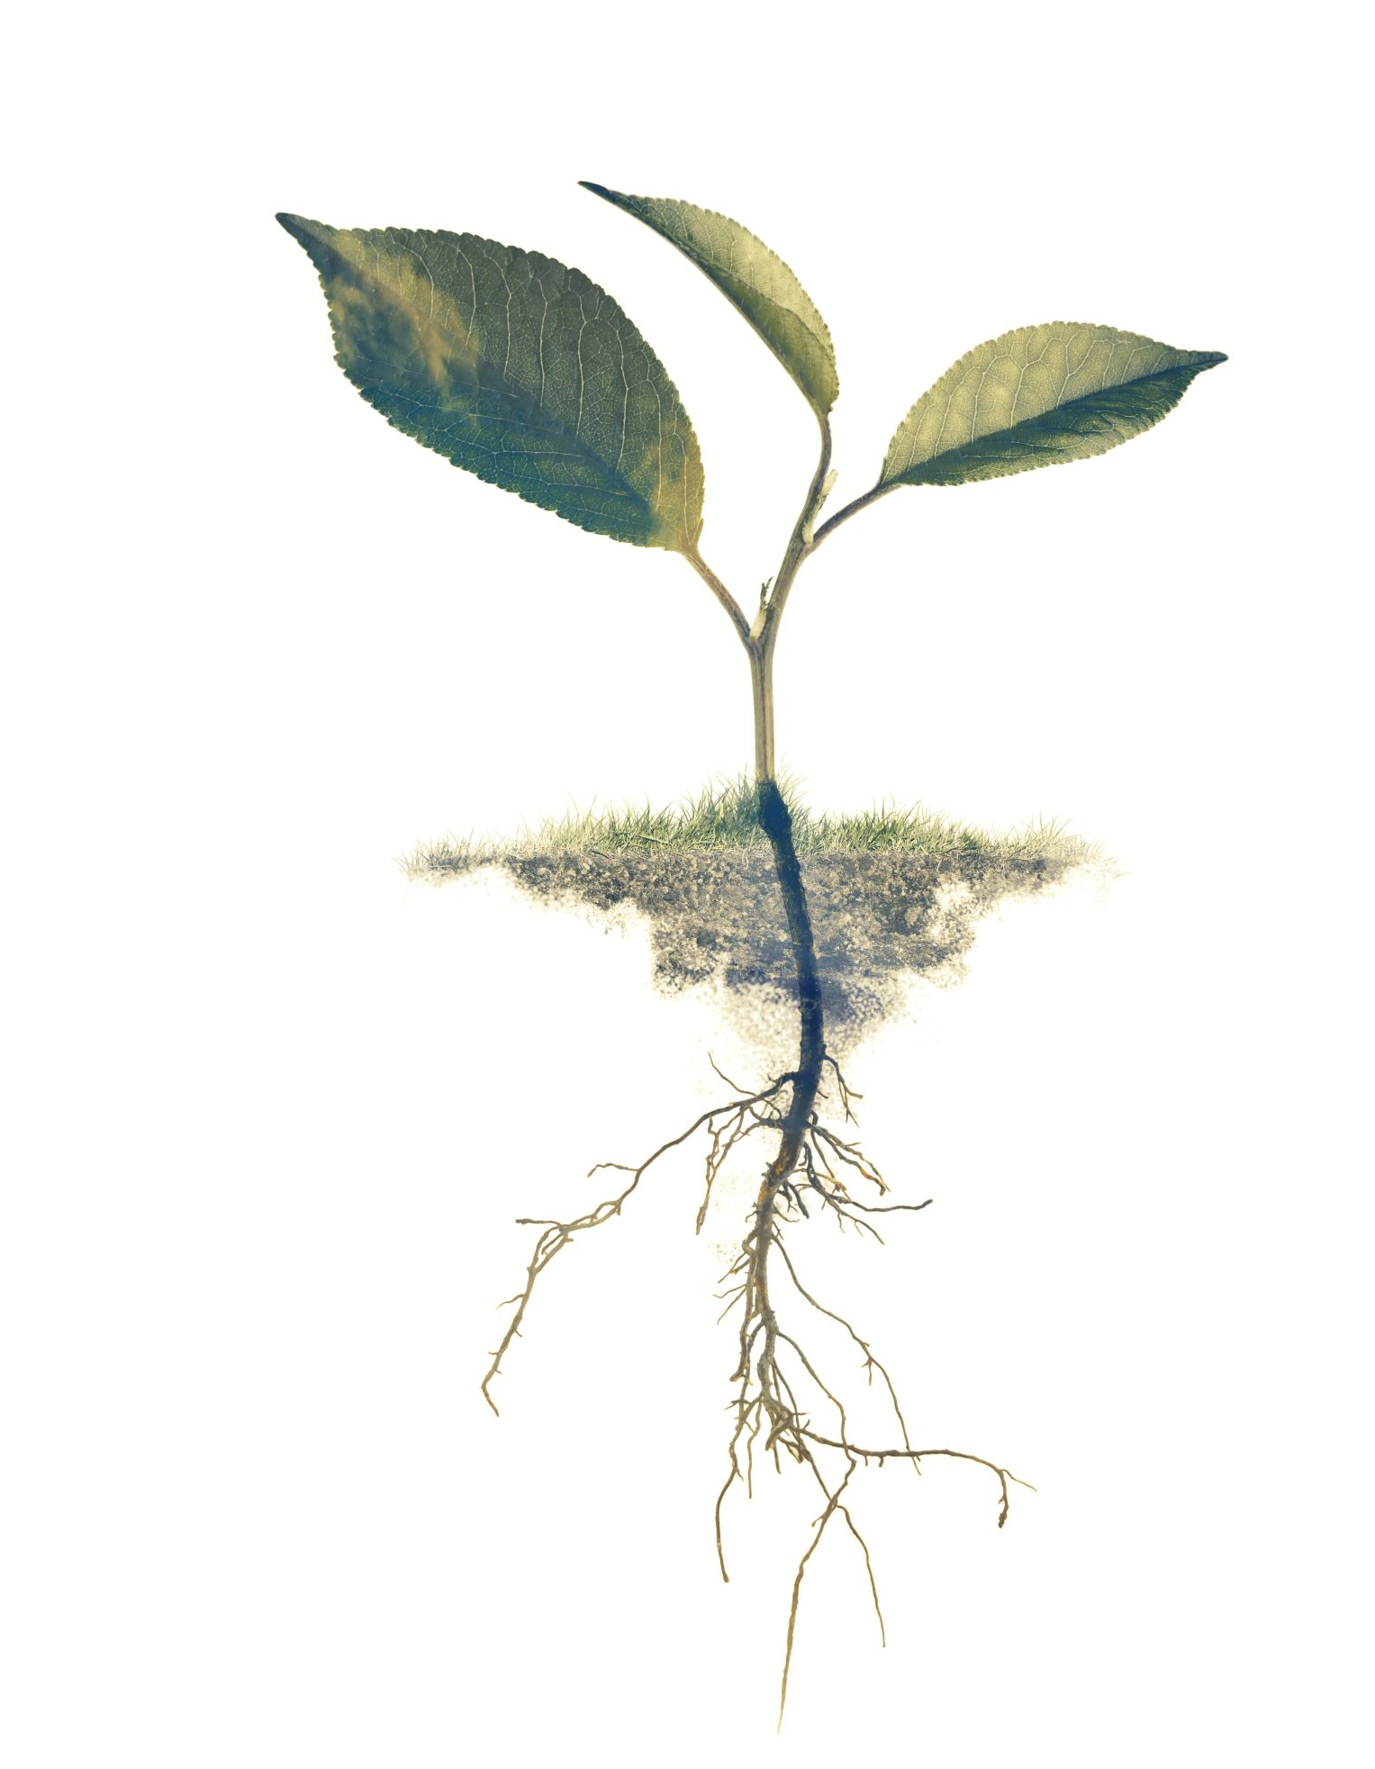
Classes Detected by MobileNetV2
MobileNetV2 is an efficient deep learning model suitable for plant disease detection tasks, including diseases like Apple Scab, Leaf Blast, Powdery Mildew, and more.

Slide 9
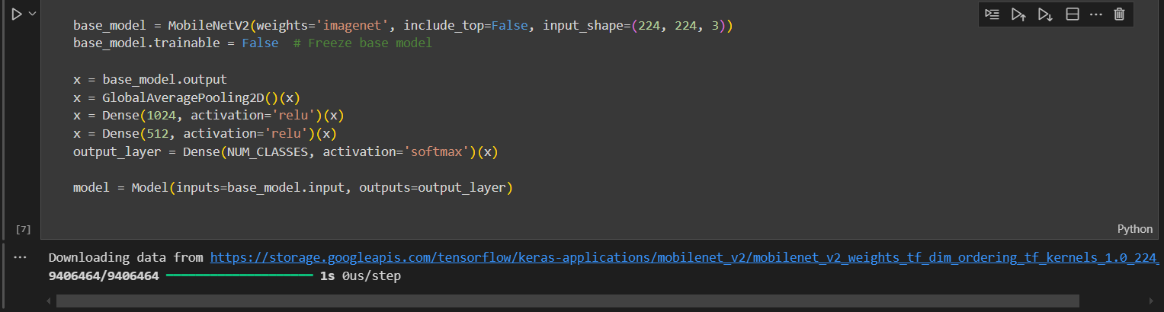
Building the Custom MobileNetV2Model for Plant Disease Classification

Slide 10
Model Architecture
Residual Block 4 (28 x28 x 64)
Input (224 x 224 x 3)
Residual Block 5 (14 x 14 x 96 )
Conv1 (112 x 112 x 32)
Residual Block 6 (7 x 7 x 160 )
Residual Block 1 (112 x 112x 16)
Final Conv Layer ( 7 x 7 x 1280)
Residual Block 2 (112 x112 x 24)
Global Average Pooling
(1 x 1 x 1280 )
Residual Block 3 (56 x 56 x 32)
Softmax (1000)

Slide 11
Training and Evaluation Process
The model is trained over multiple epochs to learn patterns from the training data.
After each epoch, training accuracy and loss are recorded to monitor learning progress.
The model is also evaluated on a separate test dataset to assess generalization performance.
Accuracy and loss values are stored after each epoch to visualize performance trends.
This helps in identifying overfitting, underfitting, or the need for more epochs.

Slide 12
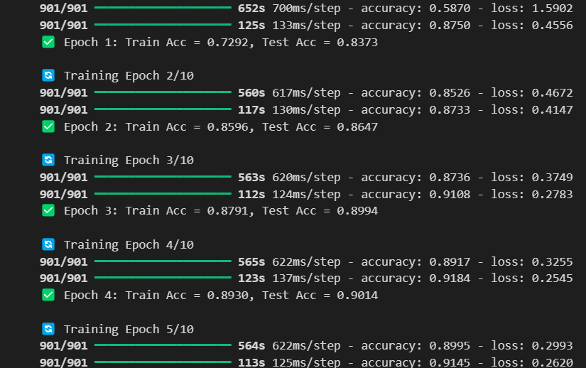
Epoch-wise Training Progress

Slide 13
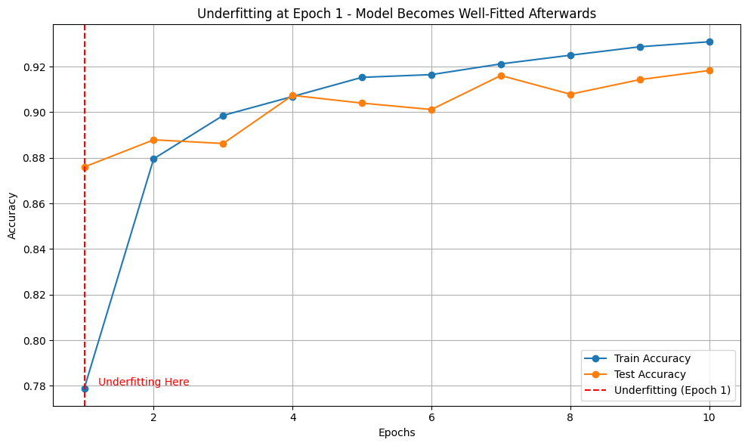
Underfitting

Slide 14
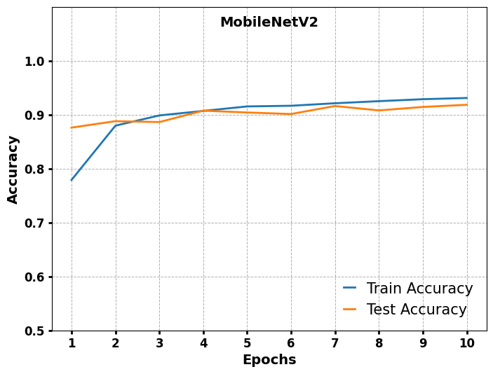
Model Train and Test Accuracy

Slide 15
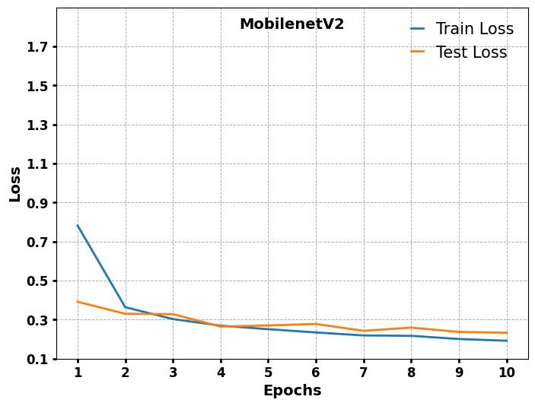
Model Train and Test Loss

Slide 16
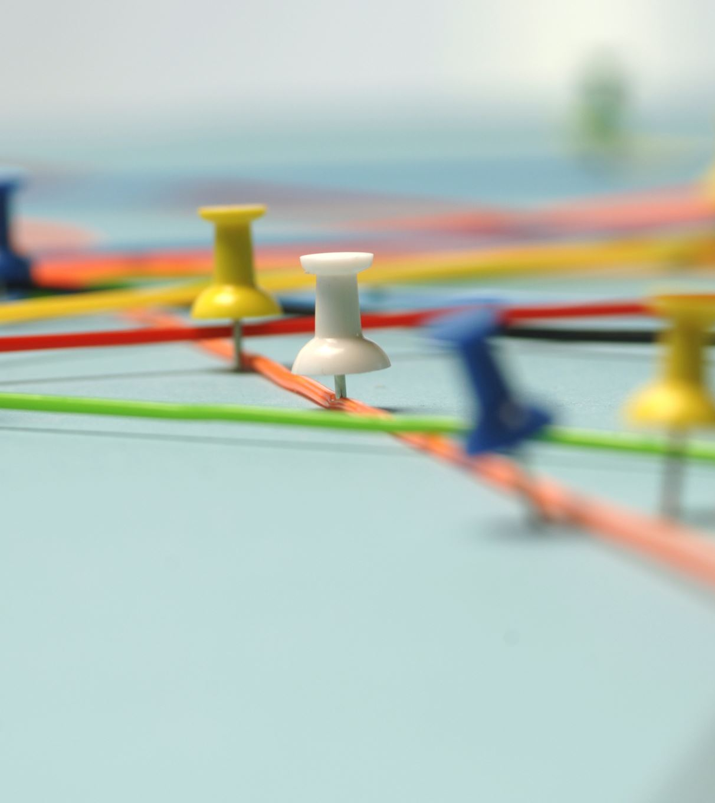
Model Accuracy
Model | Train Accuracy (%) | Test Accuracy (%) | Validation Accuracy (%)
MobileNetV2 | 93.45 | 91.83 | 92.45

Slide 17
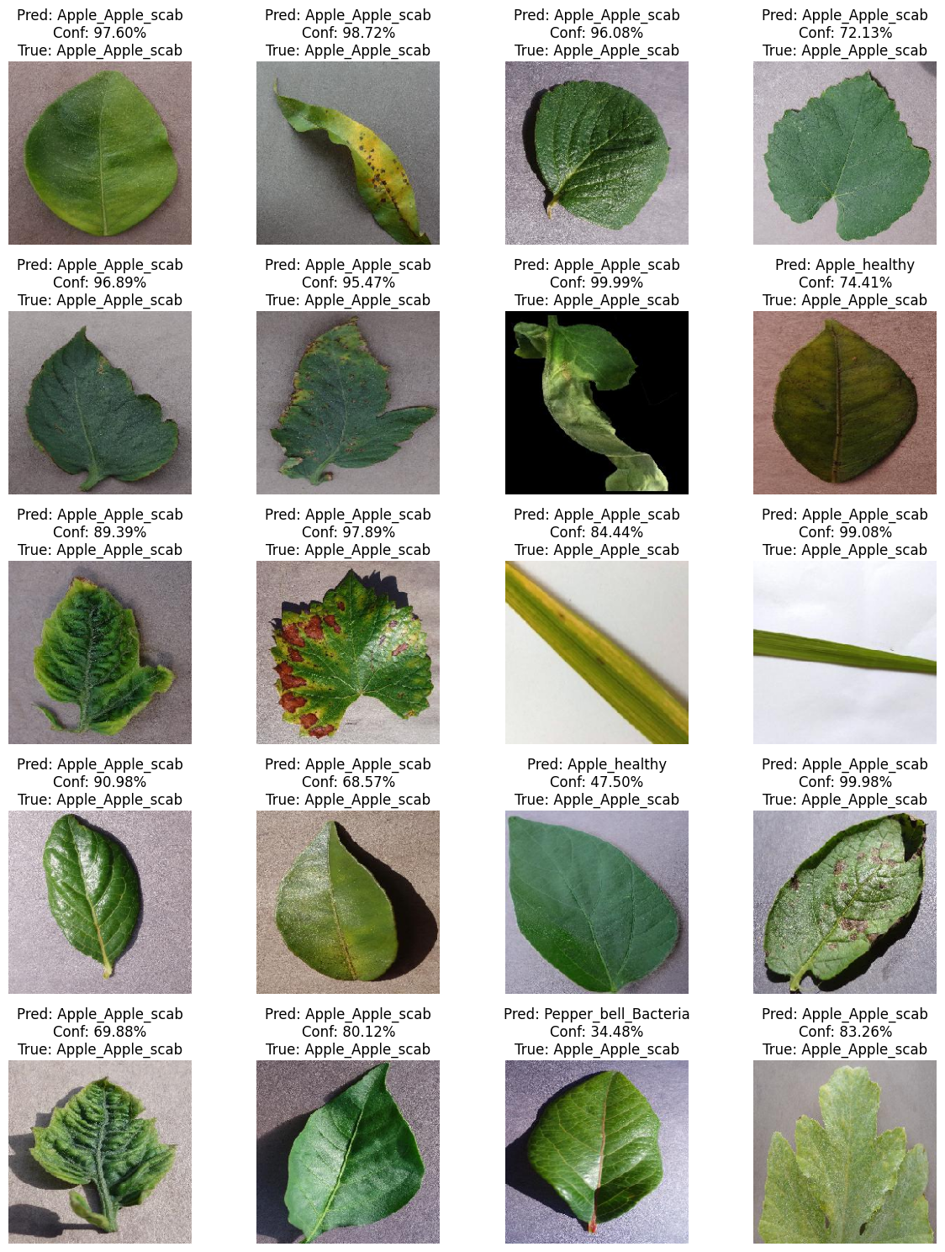
Testing the Model
Test model with unseen images to from validation data ensure generalization.

Slide 18
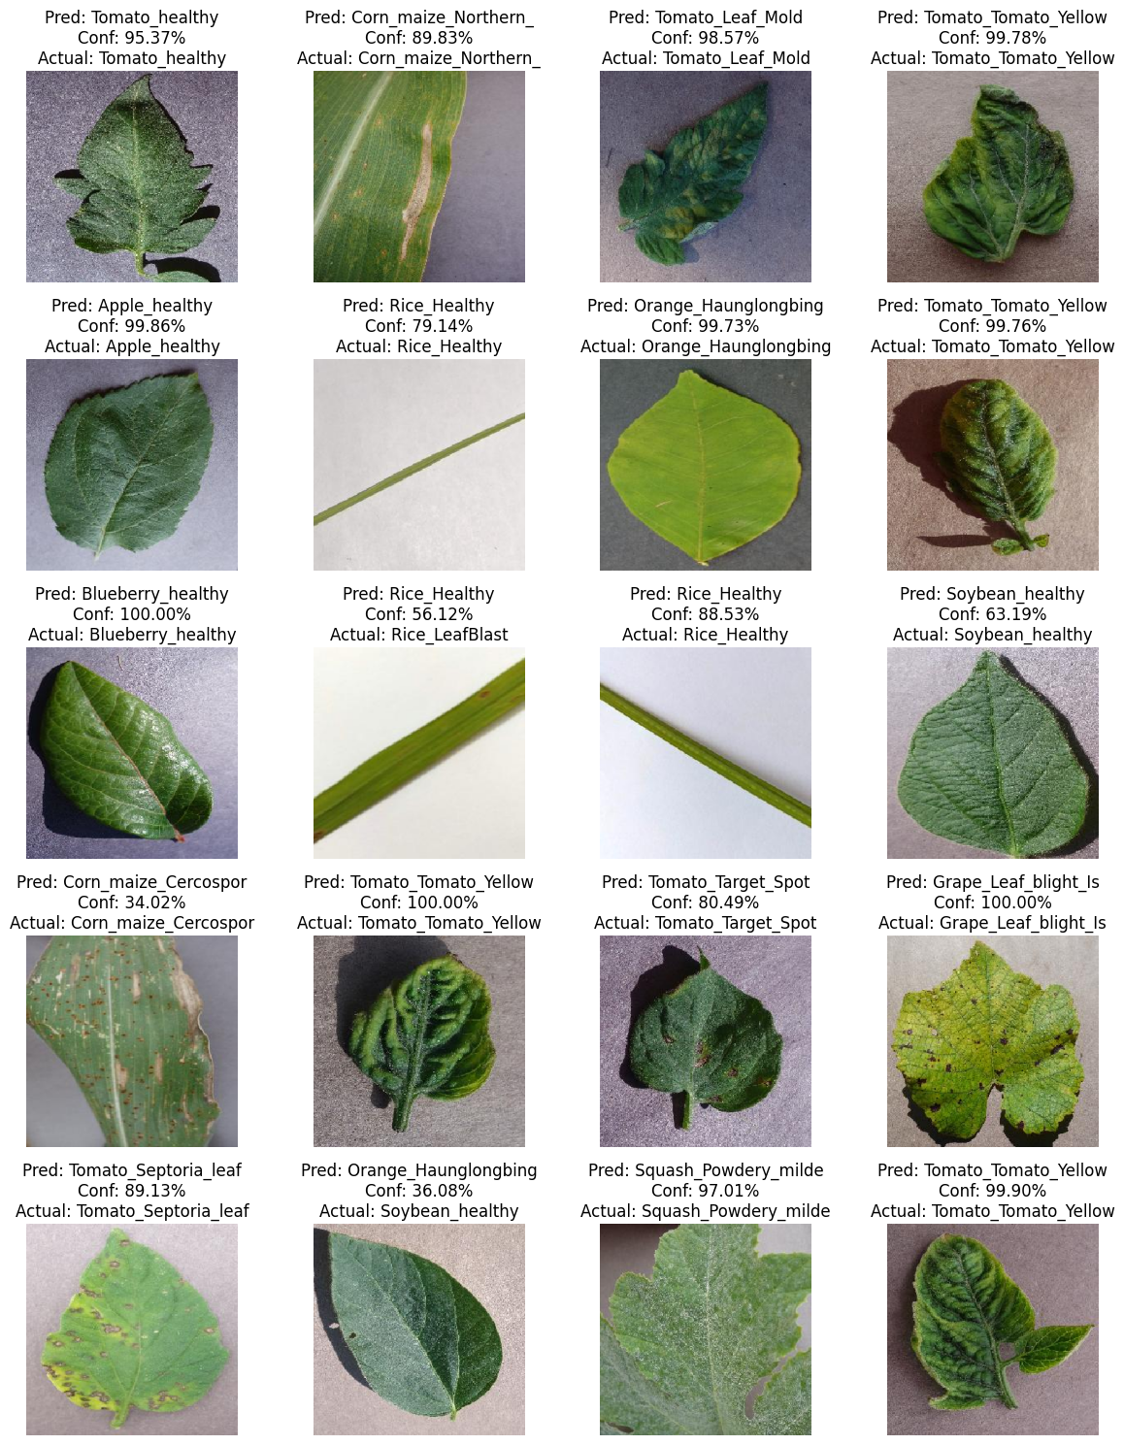
Predicted vs Actual

Slide 19
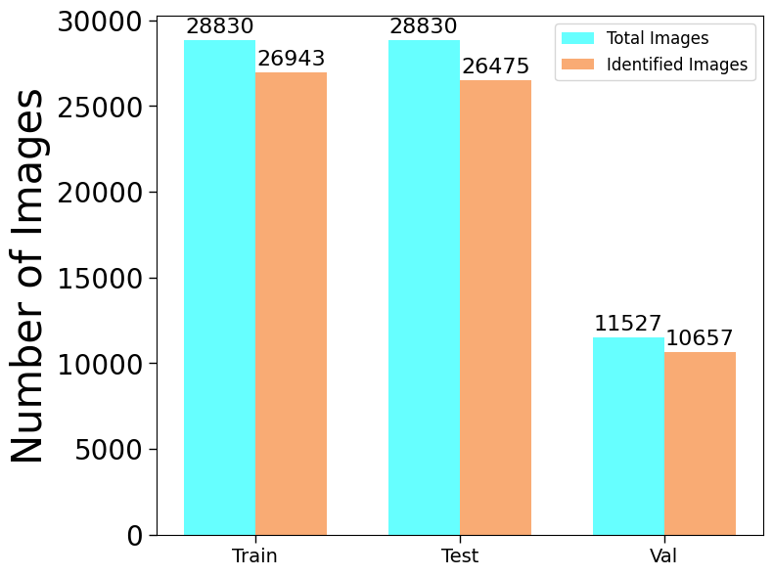
Model Accuracy: Correct Class vs Total Images Graph

Slide 20

Challenges in Disease Detection
Challenges include class imbalance, overfitting, and dataset size.

Slide 21

Solutions and Improvements
Solutions involve data augmentation, dropout layers, and larger datasets.

Slide 22

Deployment
Model deployment using streamlit
Model Saved Using: model.save('agri_model.h5’)
Deployment Tool: Streamlit – Easy-to-use Python web app framework
App Features:
Upload leaf images
Display prediction class and confidence
Show original and predicted label

Slide 23

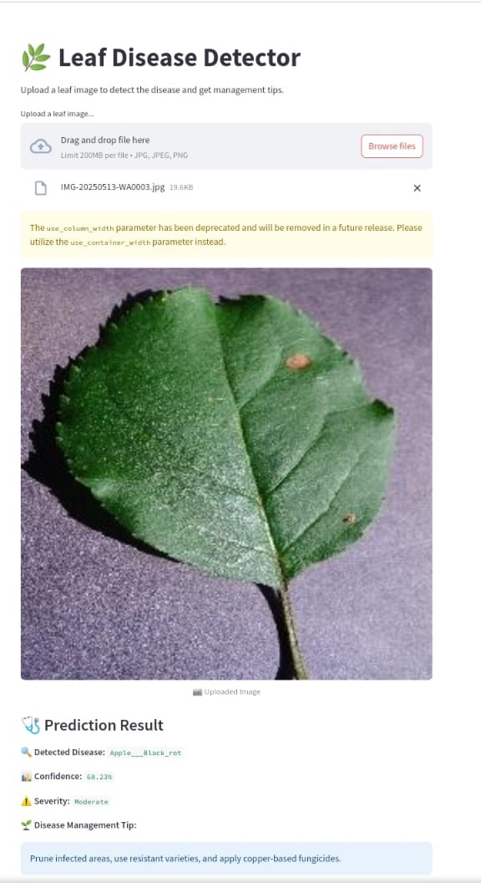
Deployment Results

Slide 24
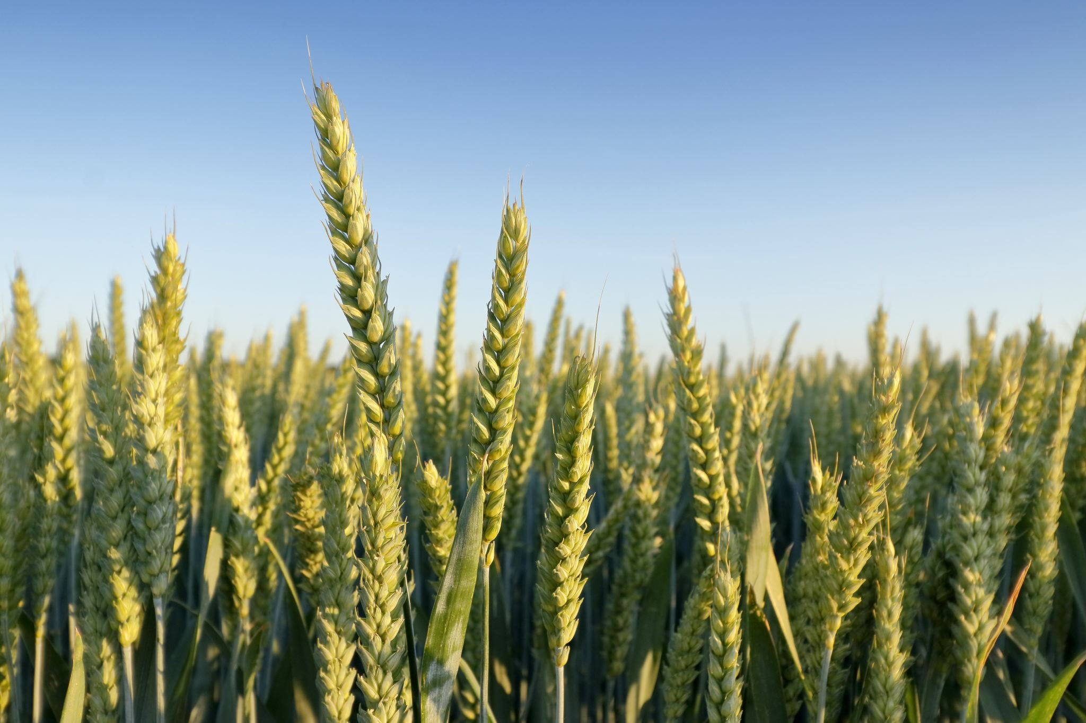
Role of AI in Agriculture
AI in agriculture enables early disease detection, reducing chemical reliance and improving crop management.

Slide 25
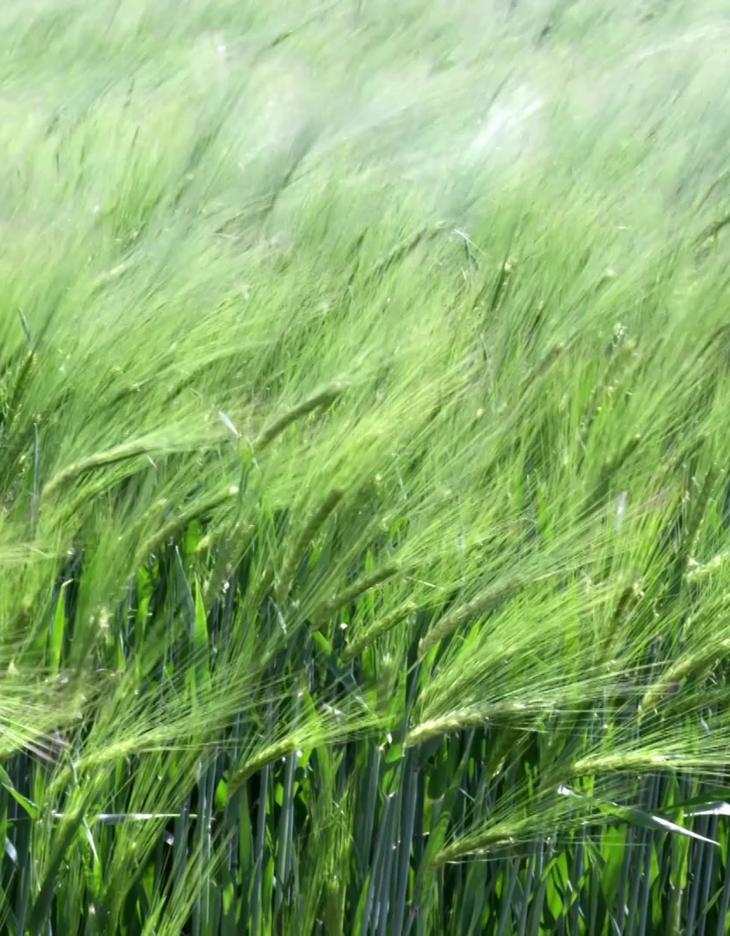
Use Cases in Agriculture
AI aids precision farming and minimizes pesticide use, improving disease detection accuracy.

Slide 26
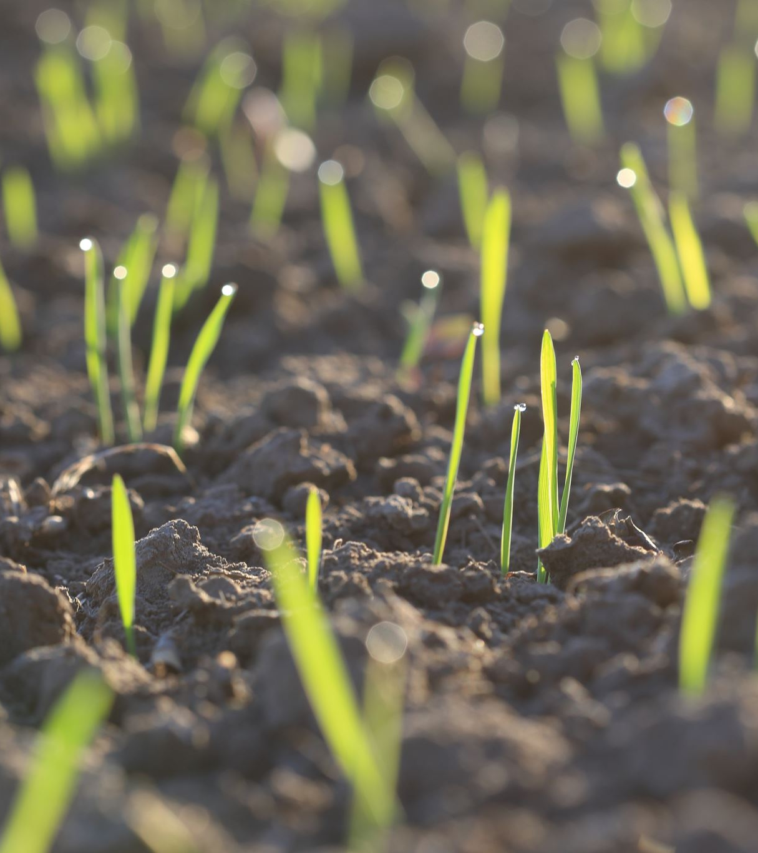
Impact on Farmers
Timely treatments prevent losses, benefiting farmers and increasing crop yield.

Slide 27
Future Scope
Future improvements: real-time monitoring, edge devices, better model generalization.

Slide 28
Conclusion
Summary: AI's role in enhancing agriculture through automated disease detection.

Slide 29
References
Sources: Kaggle, PlantVillage, TensorFlow Docs, Research Articles.

Slide 30

Thank You / Q&A
Thank you for your attention! Any questions?

